Slide 1
Drug Trends Training for Educators, Parents and Other Community Members
Presentation Created for
South Carolina Department of Alcohol & Other Drug Abuse Services

Slide 2
HOUSEKEEPING
This presentation is intended for educational purposes only for educators, schools, and parents (not intended for youth).
This is a drug awareness presentation. If you need more help/resources, please contact your local prevention/education agencies.
Everything is person-specific. "No one thing means any one thing."
Images are purchased stock images.
Created July 2020

Slide 3
Topics Highlighted in This Presentation
Teen marijuana trends
New forms of marijuana
Youth vaping trends and dangers
State-specific information
Resources for parents and professionals

Slide 4
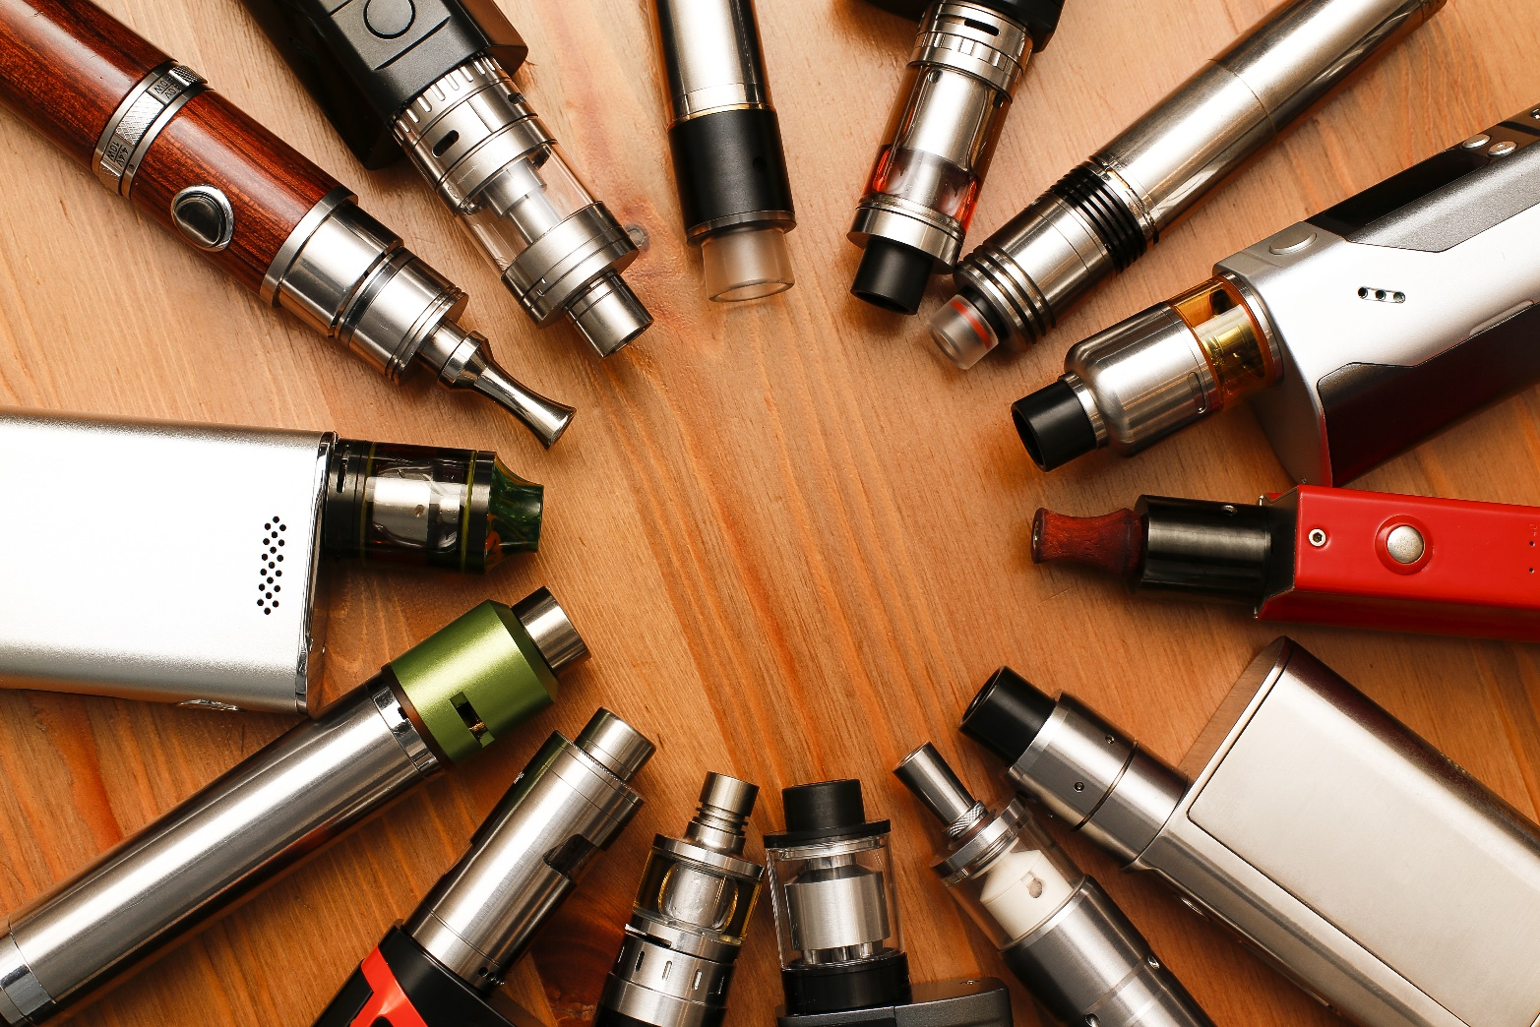
VAPING

Slide 5
What Is a Vape Pen ?
Vapes, vaporizers, vape pens, hookah pens, electronic cigarettes (e-cigarettes or e-cigs), and e-pipes are some of the many terms used to describe electronic nicotine delivery systems (ENDS).
ENDS are noncombustible tobacco products.
These products use an "e-liquid" that may contain nicotine, as well as varying compositions of flavorings, propylene glycol, vegetable glycerin, and other ingredients. The liquid is heated to create an aerosol that the user inhales.
Source: fda.Gov

Slide 6
Vapor Aerosol Questions
What many of us call a "vapor" the CDC and other professionals reference as an aerosol. This is what is inhaled by the user when they take a draw on the vape similar to how they would take a draw from a regular tobacco cigarette.
In other words, the "vapor" is actually an "aerosol."

Slide 7
What Is E-cigarette Aerosol?
The e-cigarette aerosol that users breathe from the device and exhale can contain harmful and potentially harmful substances, including:
Nicotine
Ultrafine particles that can be inhaled deep into the lungs
Flavoring such as diacetyl, a chemical linked to a serious lung disease
Volatile organic compounds
Cancer-causing chemicals
Heavy metals such as nickel, tin, and lead
It is difficult for consumers to know what e-cigarette products contain. For example, some e-cigarettes marketed as containing 0% nicotine have been found to contain nicotine.
Source: cdc.gov

Slide 8
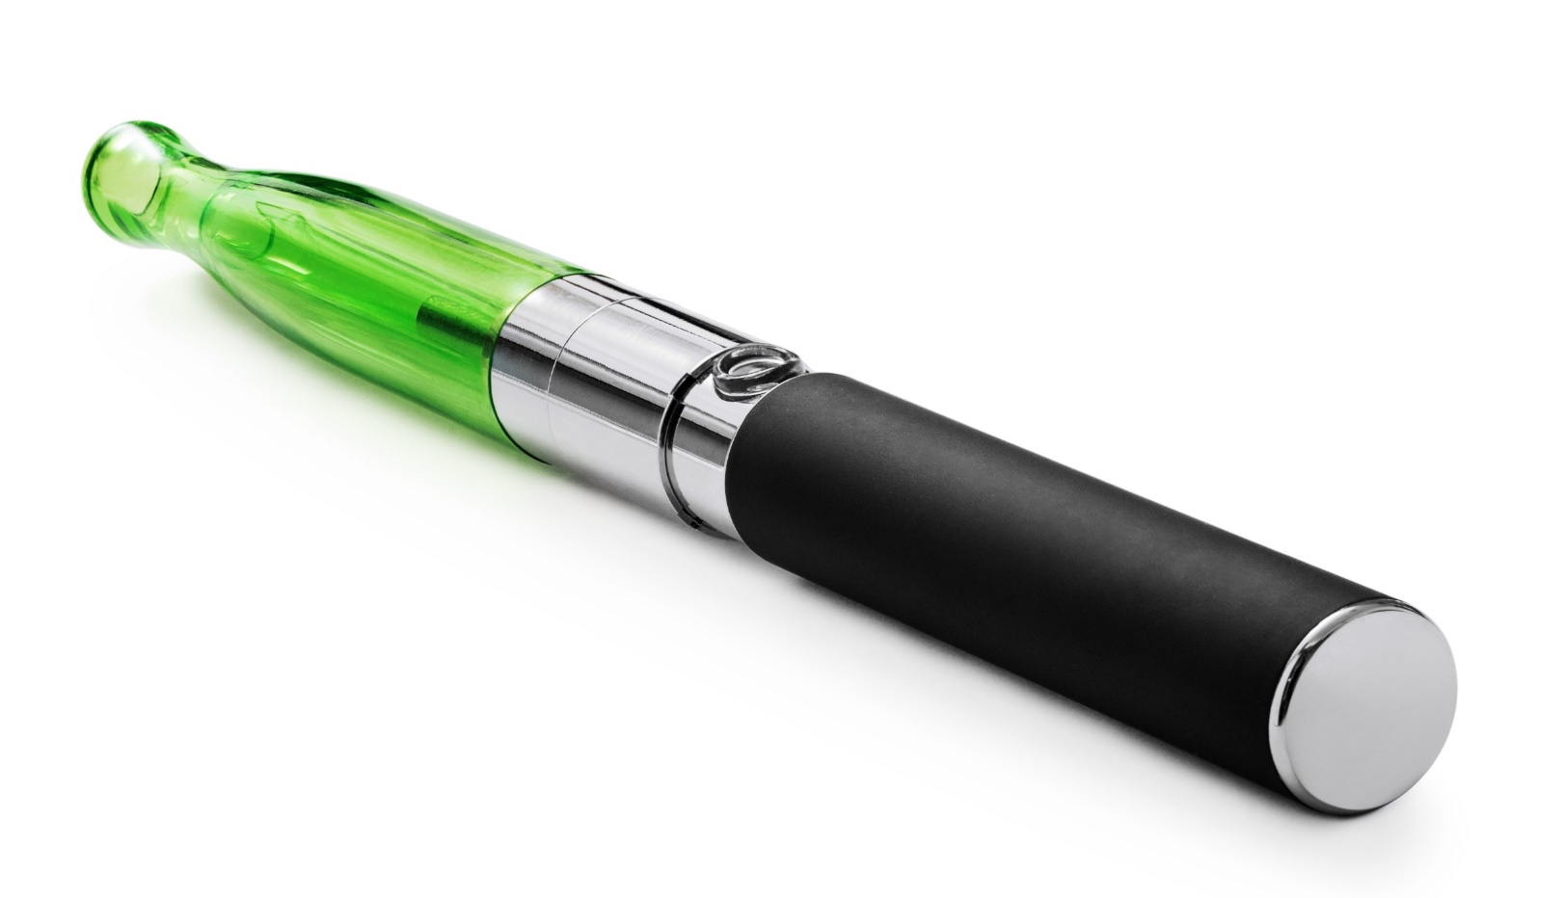
Vape Pen (AKA E-Cigarette)

Slide 9
"Street-Level" Terms for Vape Pens
E-cigarette (E-cig) or Electronic Cigarette – the device we know as a "vape pen"
Dab Pen - a device used for the consumption of marijuana concentrates. Dab pens can look like standard nicotine vape pens.
MOD(s) – a larger, bulkier, (modified) device that can include certain features or customizations
Keep in mind that vape terminology is person-specific and can vary by individual and region.

Slide 10
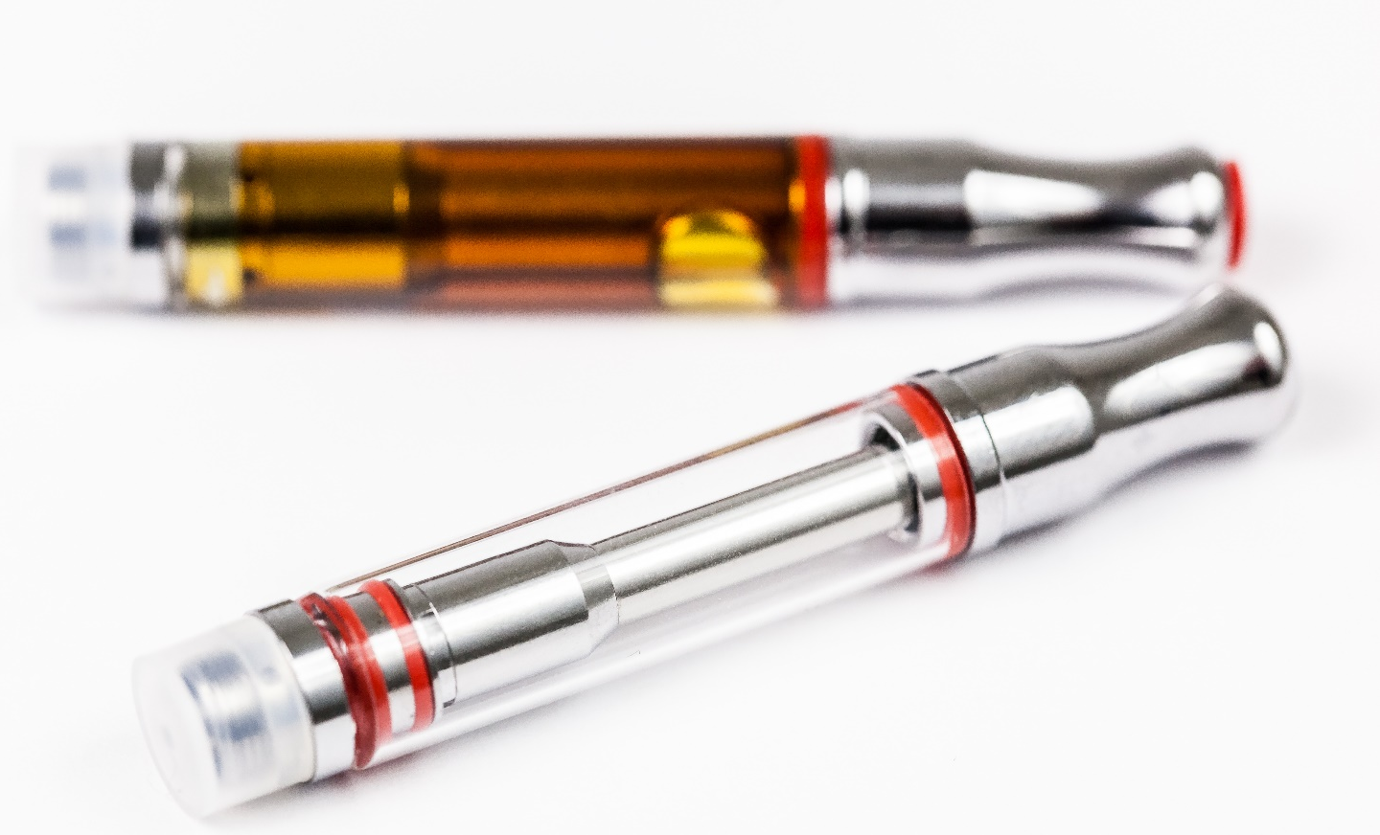
Vape Cartridges, Batteries & USB
Vape
Cartridges

Slide 11
Harms to Teens
The use of e-cigarettes is unsafe for kids, teens, and young adults.
Most e-cigarettes contain nicotine. Nicotine is highly addictive and can harm adolescent brain development, which continues into the early- to mid-20s.
E-cigarettes can contain other harmful substances besides nicotine.
Young people who use e-cigarettes may be more likely to smoke cigarettes in the future.
More info: https://www.cdc.gov/tobacco/basic_information/e-cigarettes/Quick-Facts-on-the-Risks-of-E-cigarettes-for-Kids-Teens-and-Young-Adults.html
Source: cdc.gov

Slide 12
More Harms To Youth
Most e-cigarettes contain nicotine, the highly addictive drug in tobacco. Nicotine is especially harmful to young people. The human brain keeps developing until around the age of 25. Using products with nicotine under age 25 can harm the part of the brain responsible for memory, attention, and learning.
More Info: https://www.cdc.gov/tobacco/features/back-to-school/e-cigarettes-talk-to-youth-about-risks/index.html
Source: cdc.gov

Slide 13
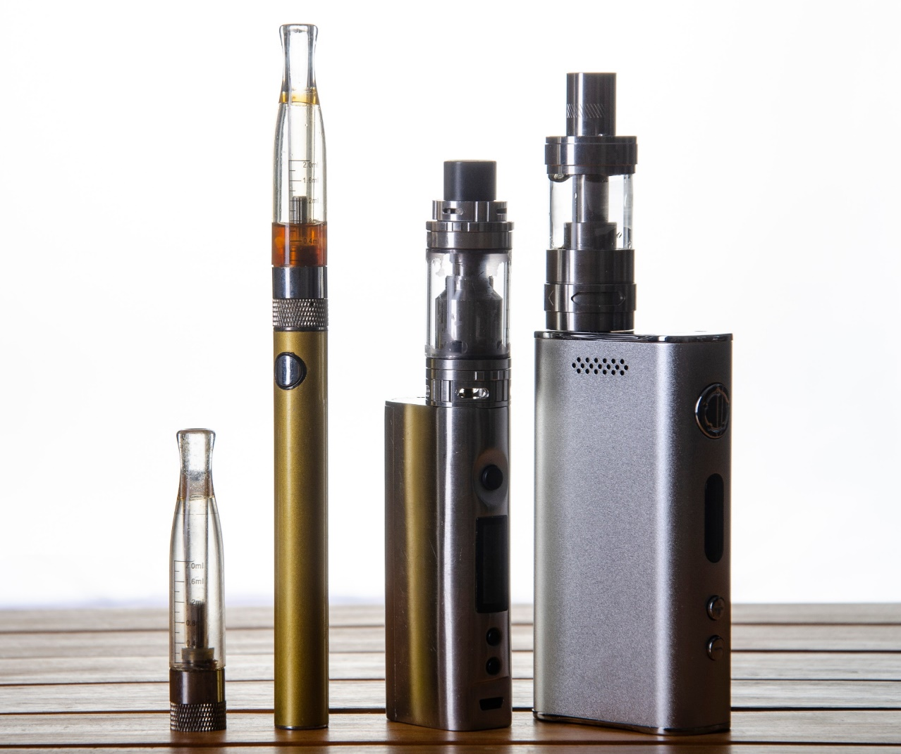
Vape Pens / E-Cigs at a Glance
VAPE
CARTRIDGE
MOUTHPIECE
VAPE BATTERY
MOD
VAPE DEVICE
MOD
VAPE DEVICE

Slide 14
Nicotine Addiction & Withdrawal
Nicotine addiction can look different from person to person. Even if you only use tobacco once in a while, you can be addicted and can have a hard time quitting.
Signs of nicotine addiction include:
Cravings, or feeling like you really need to use tobacco
Going out of your way to get tobacco
Feeling anxious or irritable if you want to use tobacco but can’t
Continuing to use tobacco because you find it hard to stop
When you’re addicted to nicotine, you may experience symptoms of nicotine withdrawal after you stop using tobacco. Craving cigarettes, feeling sad or irritable, or having trouble sleeping are some common symptoms of withdrawal. These symptoms are usually strongest in the first week after quitting, but they are only temporary.
Source: https://teen.smokefree.gov/the-risks-of-tobacco/nicotine-addiction

Slide 15
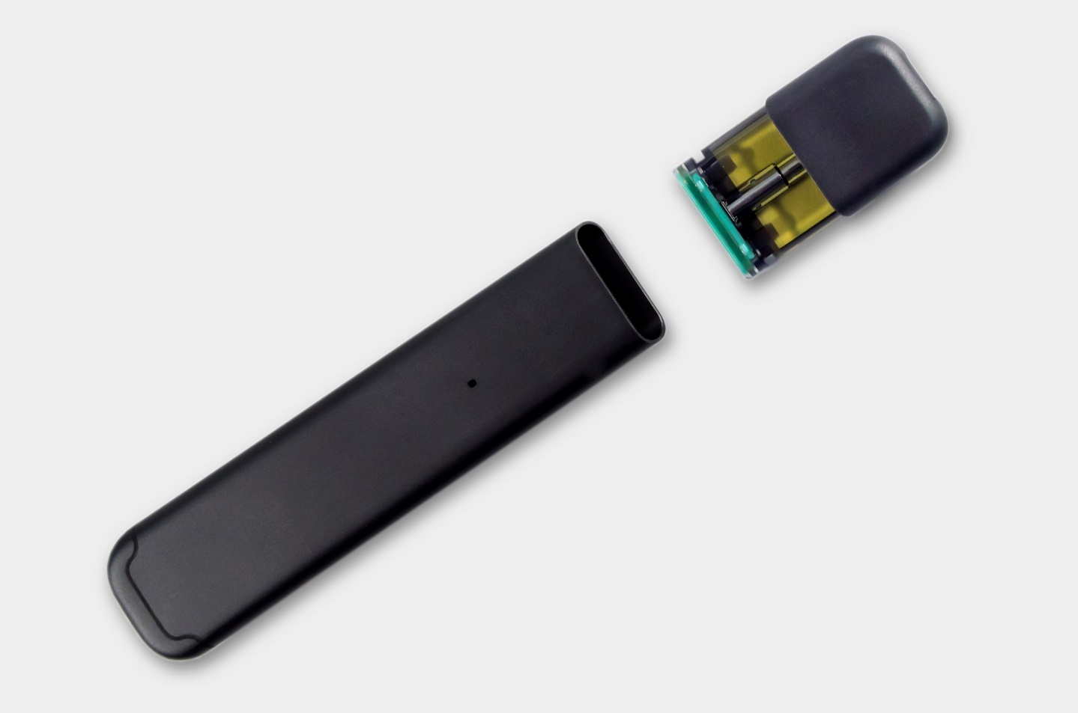
Vapes & Vape Pod Systems

Slide 16
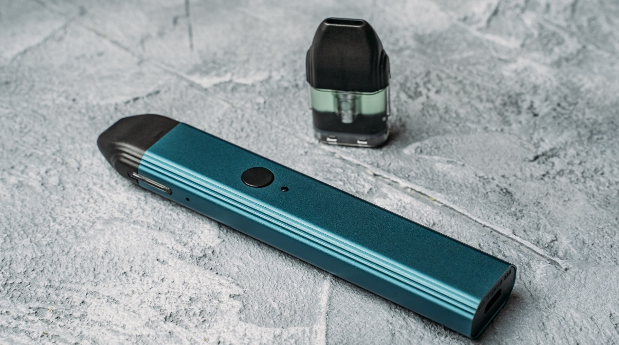
Devices With Pods
A two-part vape pen that includes a battery and a removable pod
The pod is either prefilled (generally disposable) or refillable (generally reusable).
Also known as vape pods or pod mods

Slide 17
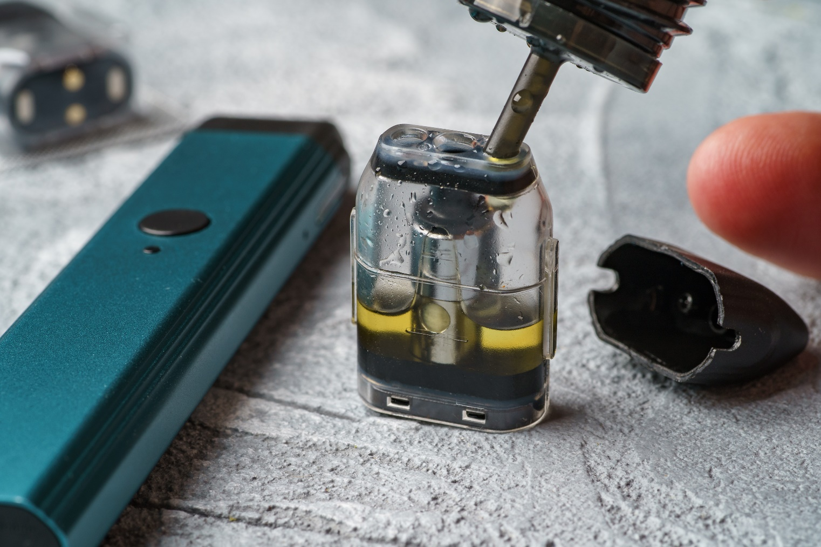
Self-Loading Vape Pods

Slide 18
Preloaded Vape Devices
These are preloaded disposable vape pens.
They have an approximate number of puffs, after which you throw the entire device away.
No on/off switch – you just take a draw.
Mouthpiece is attached to device.
AKA "vape stick" or "nic stick"

Slide 19
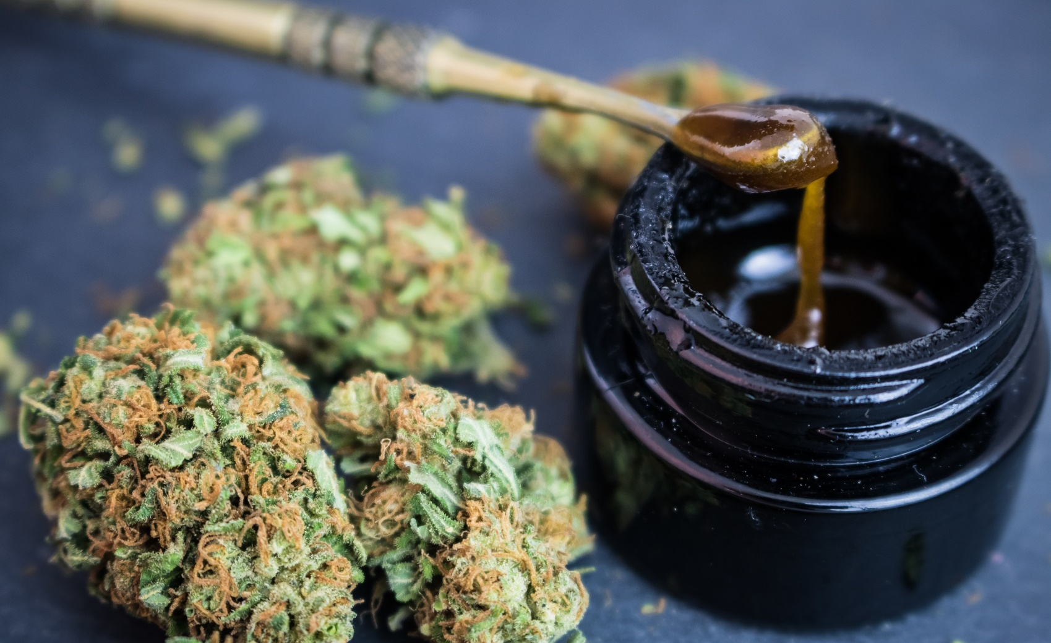
Marijuana
Traditional
Marijuana
Marijuana Wax AKA "Dab"

Slide 20
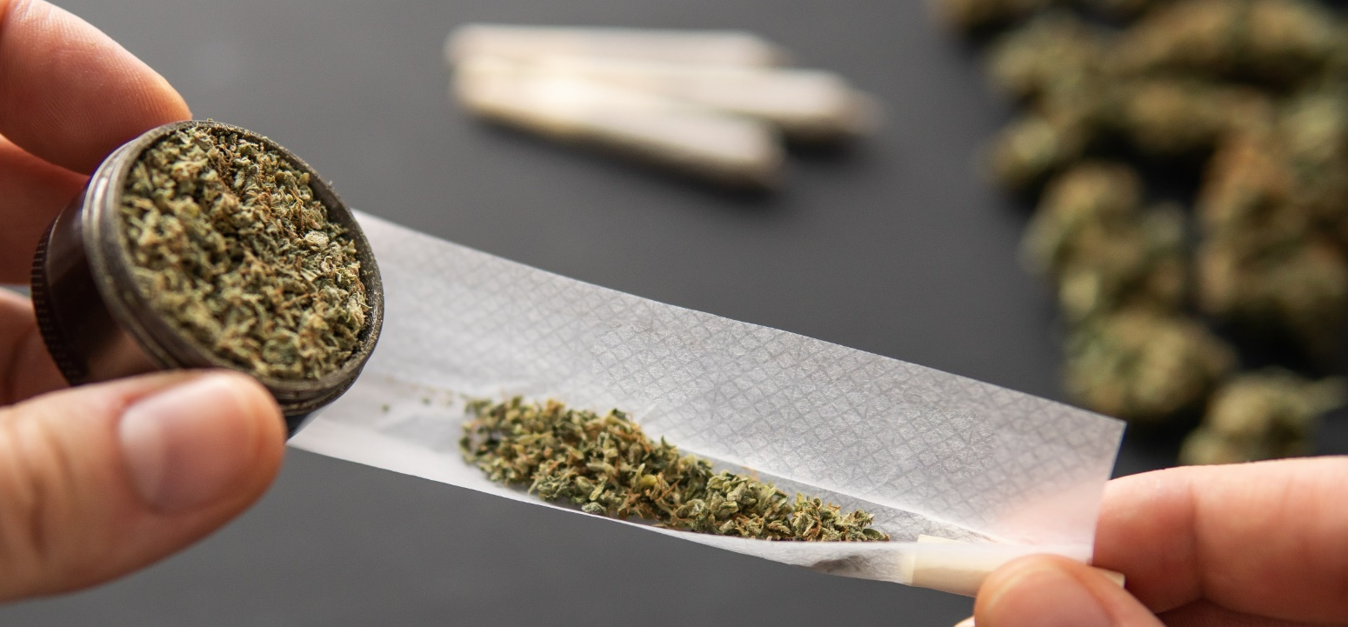
What Is Marijuana ?
Marijuana — also called weed, herb, pot, grass, bud, ganja, Mary Jane, and a vast number of other slang terms — is a greenish-gray mixture of the dried flowers of Cannabis sativa.
Source: https://www.dea.gov/factsheets/marijuana

Slide 21
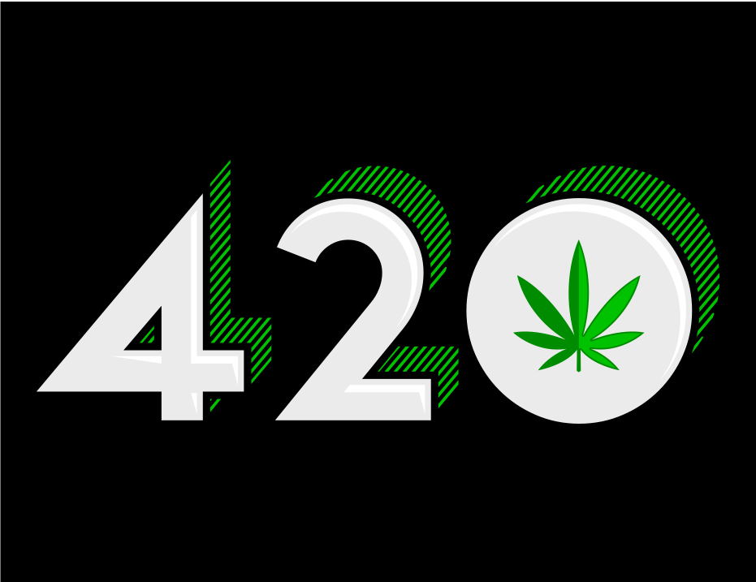
April 20 (4/20) Is Known As the National "Stoner" Holiday

Slide 22
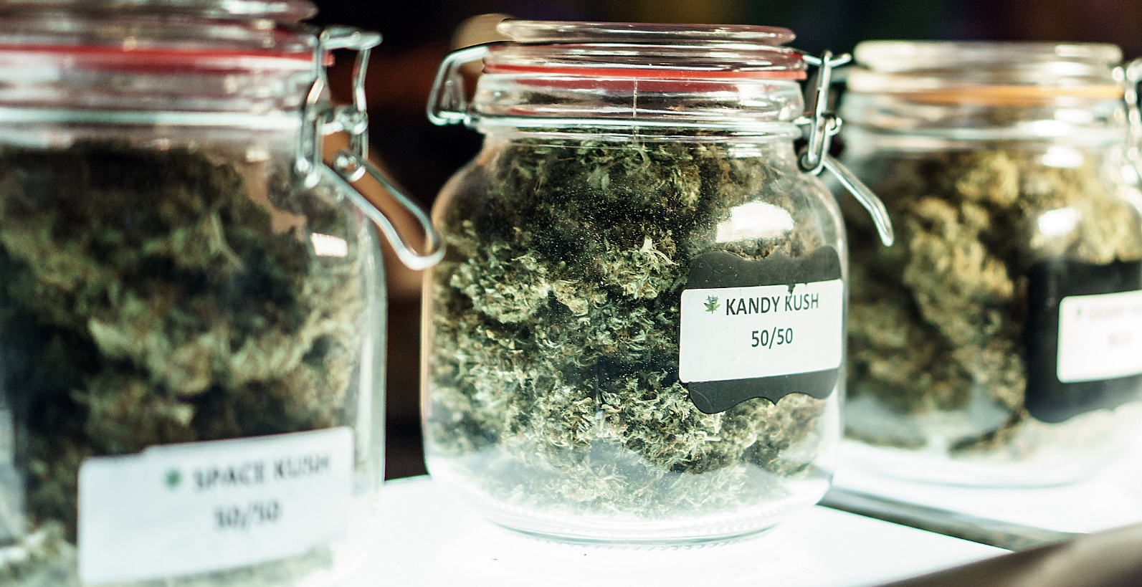
Marijuana Strains
The forms of marijuana can fall under various names, which are known as strains.

Slide 23
Cannabis Strains

Slide 24
Marijuana Use & Youth
Marijuana, like some other brain-altering substances, can be addictive. Nearly one in 10 marijuana users will become addicted. Signs that someone might be addicted include being unable to stop using marijuana, using it even though they know it is causing problems, and using marijuana instead of joining important activities with friends and family. People who frequently use marijuana often report withdrawal symptoms.
These symptoms include being irritable or restless, having a small appetite, experiencing cravings, and problems with mood and sleep. These symptoms can last up to two weeks after the last use. In 2015, about four million people in the United States met the standards for being diagnosed with a marijuana use disorder.
Source: https://www.hhs.gov/ash/oah/adolescent-development/substance-use/ marijuana/risks/index.html

Slide 25
Marijuana Use & Youth
(continued)
Starting to use marijuana at a younger age can lead to a greater risk of developing a substance use disorder later in life. Adolescents who begin using marijuana before age 18 are four to seven times more likely than adults to develop a marijuana use disorder.
Source: https://www.hhs.gov/ash/oah/adolescent-development/substance-use/ marijuana/risks/index.html

Slide 26
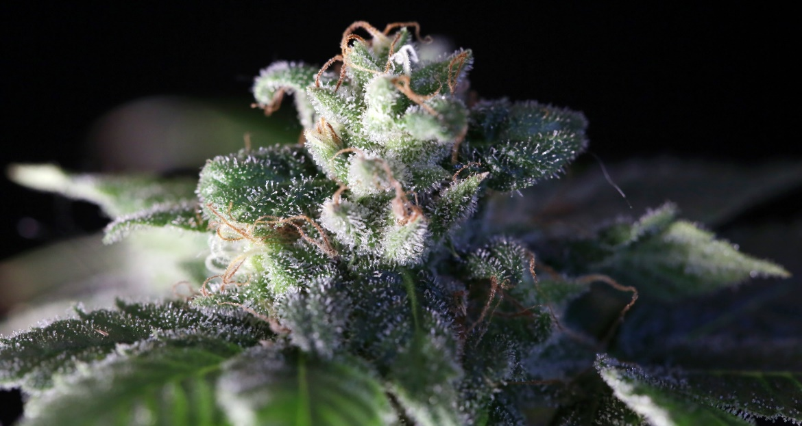
Ways to Ingest Marijuana
Smoke it from a bong, pipe, joint, or blunt
Vape
Edibles (in food or drink)
Dabbing (concentrated form)

Slide 27
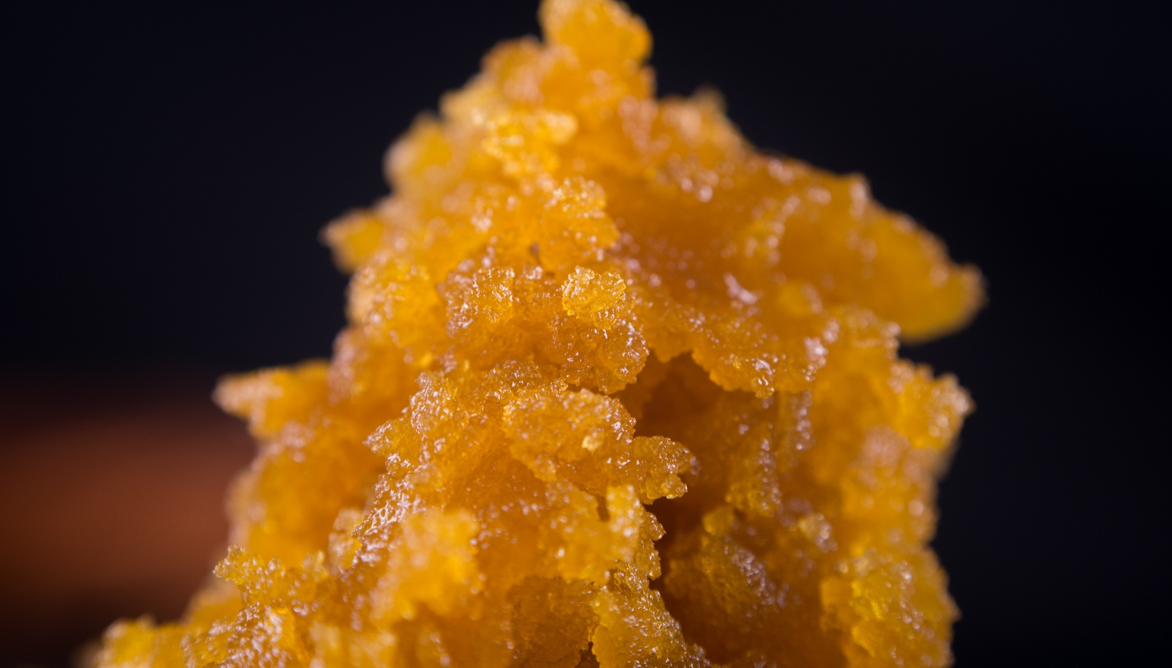
New Forms of Marijuana

Slide 28
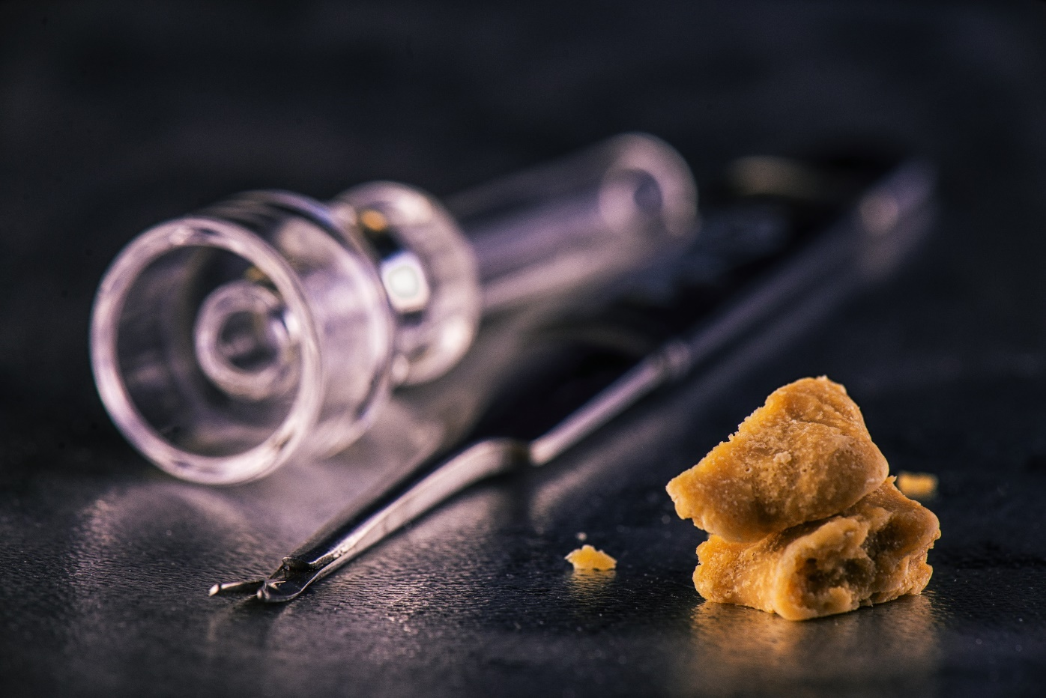
Marijuana Concentrates AKA "Dabs"
Street Names: dabs, concentrates, wax, ear wax, oil, essential oils (with THC), extracts

Slide 29
Marijuana Concentrates AKA "Dabs"
Smoking THC-rich resins extracted from the marijuana plant is on the rise. People call this practice "dabbing."
These extracts come in various forms, such as:
"hash oil" or "honey oil" — a gooey liquid
"wax" or "budder" — a soft solid with a texture like lip balm
"Shatter" — a hard, amber-colored solid
Source: https://www.drugabuse.gov/publications/drugfacts/marijuana

Slide 30
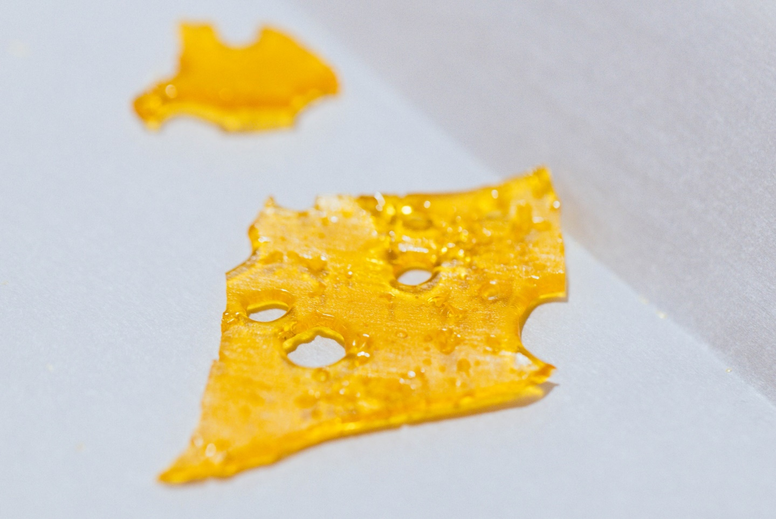
Marijuana Shatter

Slide 31
Dab Shatter Details
Some forms of shatter have as much as 90% THC, the psychoactive ingredient in marijuana. That is about five times the potency of unrefined smoked marijuana. It is more powerful than standard hash oil. Shatter is a thin, hard layer that is similar to glass. It can shatter if dropped.
Source: https://drugfree.org/drug-and-alcohol-news/ law-enforcement-sees-high-potency-marijuana-called-shatter/

Slide 32
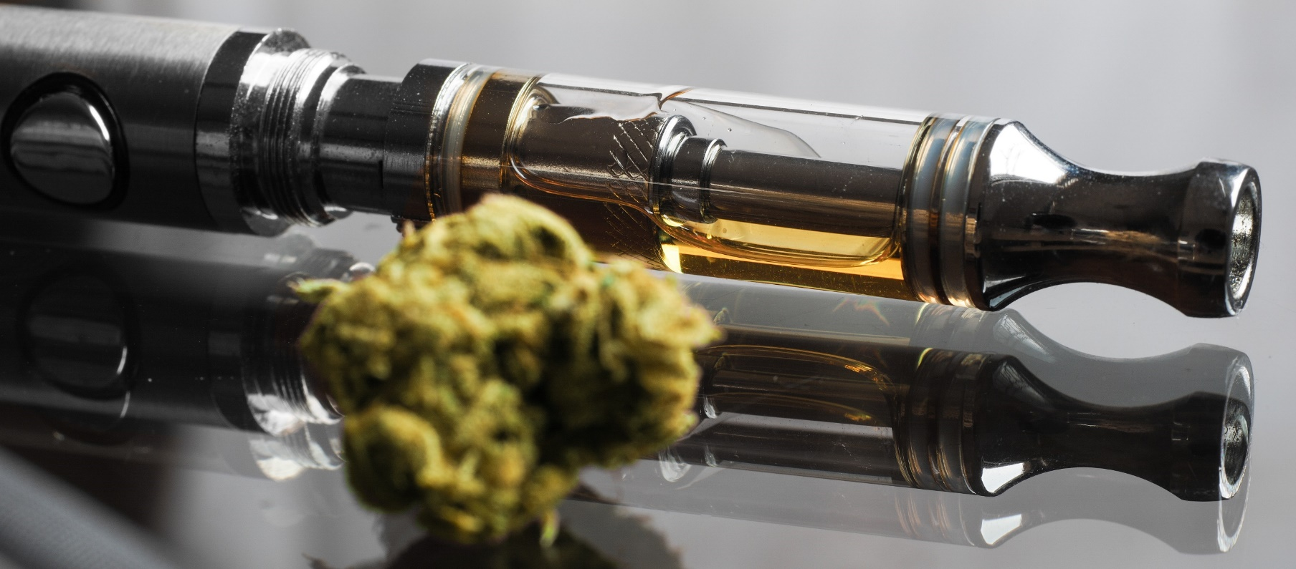
Marijuana (THC) Vapes

Slide 33
Marijuana Vapes
Marijuana vapes can be hard to distinguish from some nicotine vapes.
Many can work for:
Dry leaf marijuana
Dabs or concentrated forms of marijuana
Marijuana oils

Slide 34
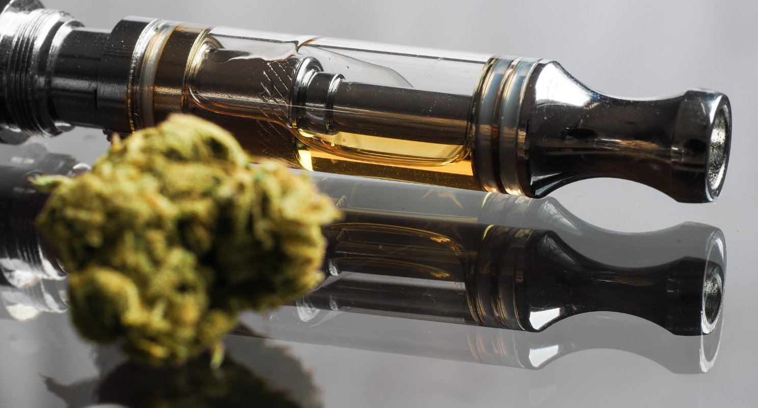
Various cannabis vapes can use a leaf form while others can use an oil form.

Slide 35
Vapes Are Also Being Used for Some CBD Products

Slide 36
Vapes & Marijuana More Common
Vaping marijuana continues to dramatically increase in popularity among teens, according to numbers from the latest Monitoring the Future study.
In 2019, 14% of high school seniors admitted to vaping marijuana in the past month. This is almost double the percentage from 2018.
In addition, 21% of 12th-graders reported vaping marijuana within the past year - an increase from the 13.1% in 2018.

Slide 37
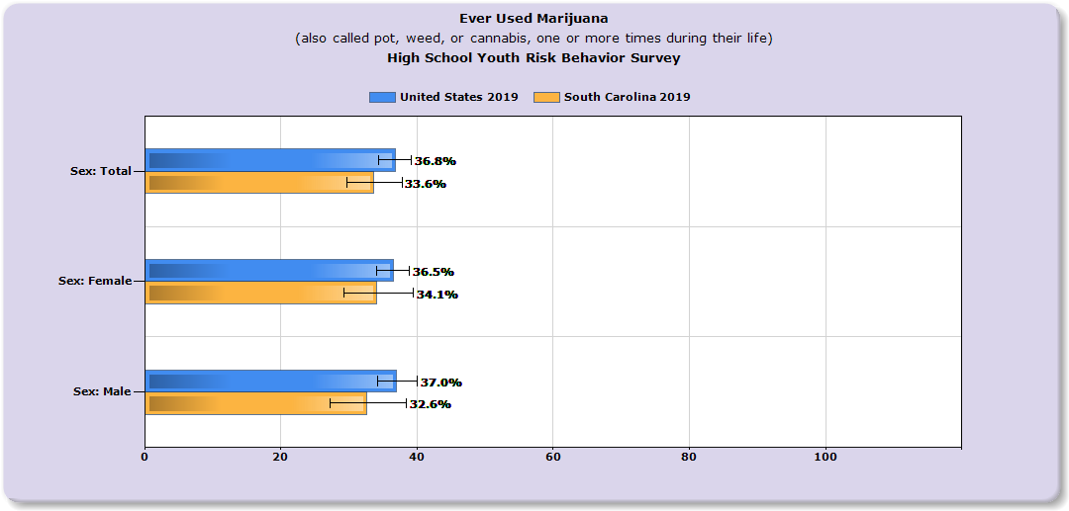
South Carolina Data
Source: https://nccd.cdc.gov/youthonline/App/Results

Slide 38
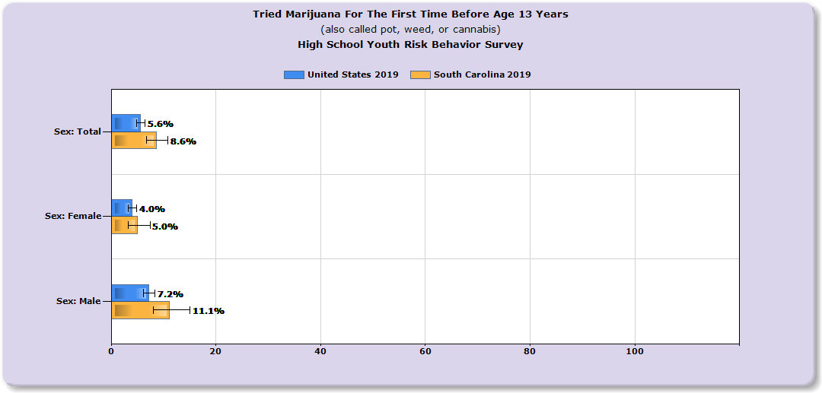
South Carolina Data
Source: https://nccd.cdc.gov/youthonline/App/Results

Slide 39
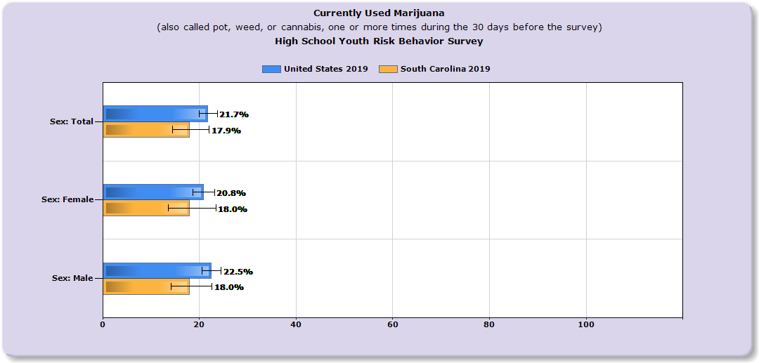
South Carolina Data
Source: https://nccd.cdc.gov/youthonline/App/Results

Slide 40
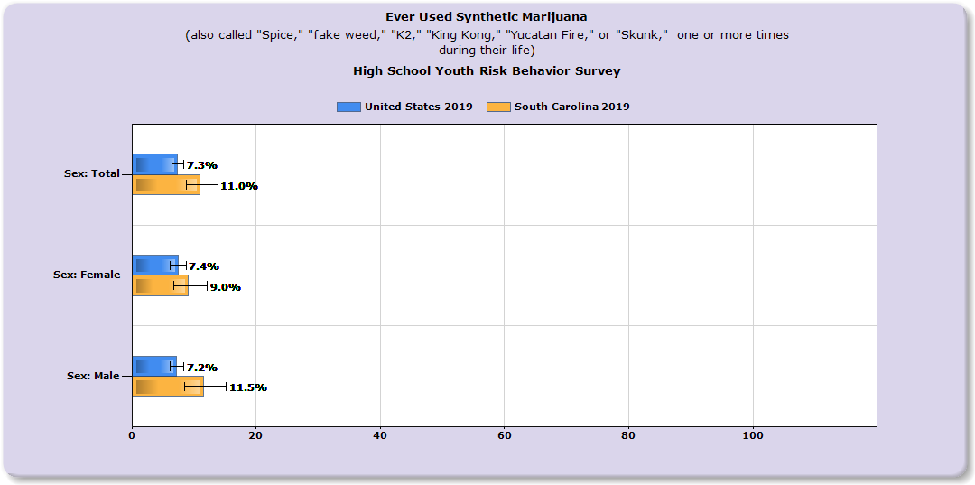
South Carolina Data
Source: https://nccd.cdc.gov/youthonline/App/Results

Slide 41
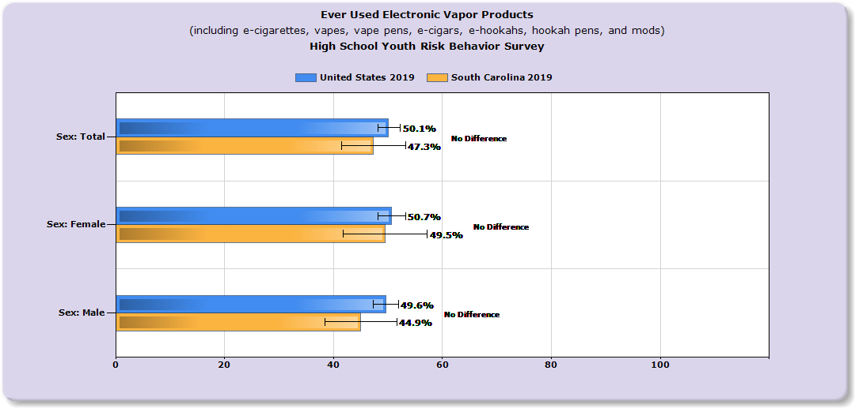
South Carolina Data
Source: https://nccd.cdc.gov/youthonline/App/Results

Slide 42
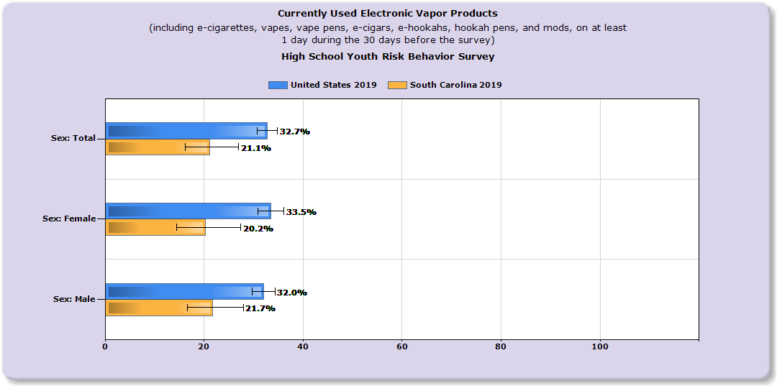
South Carolina Data
Source: https://nccd.cdc.gov/youthonline/App/Results

Slide 43
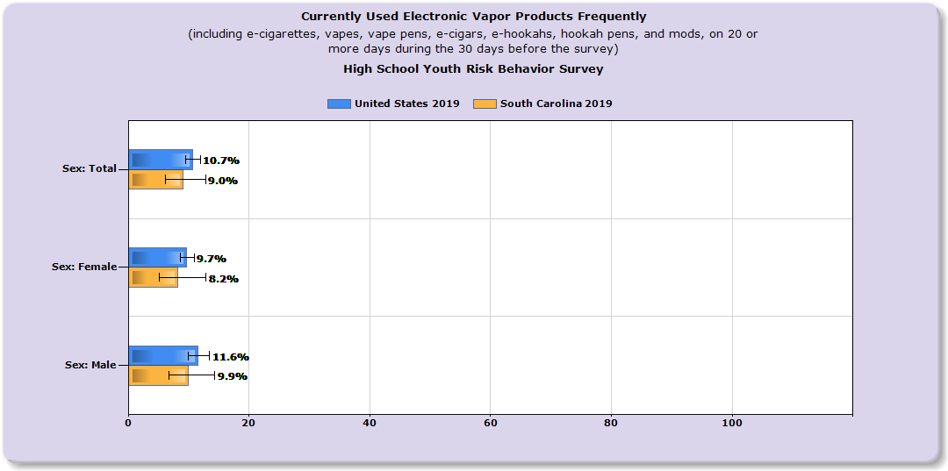
South Carolina Data
Source: https://nccd.cdc.gov/youthonline/App/Results

Slide 44
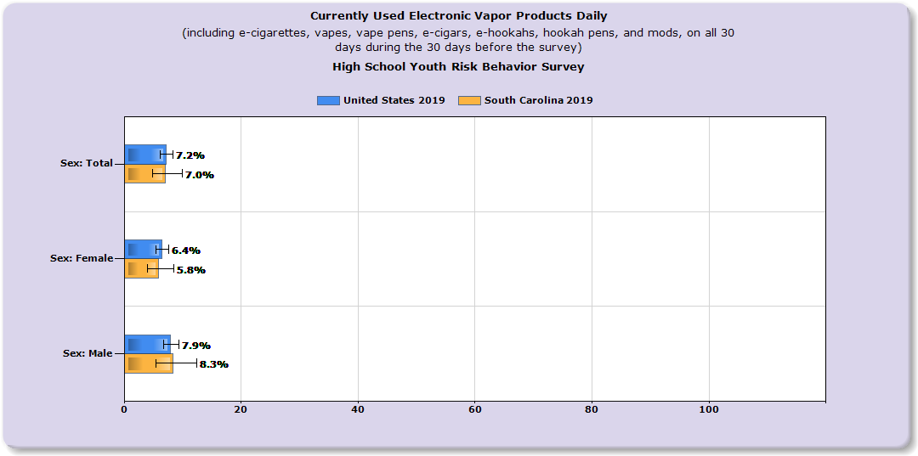
South Carolina Data
Source: https://nccd.cdc.gov/youthonline/App/Results

Slide 45
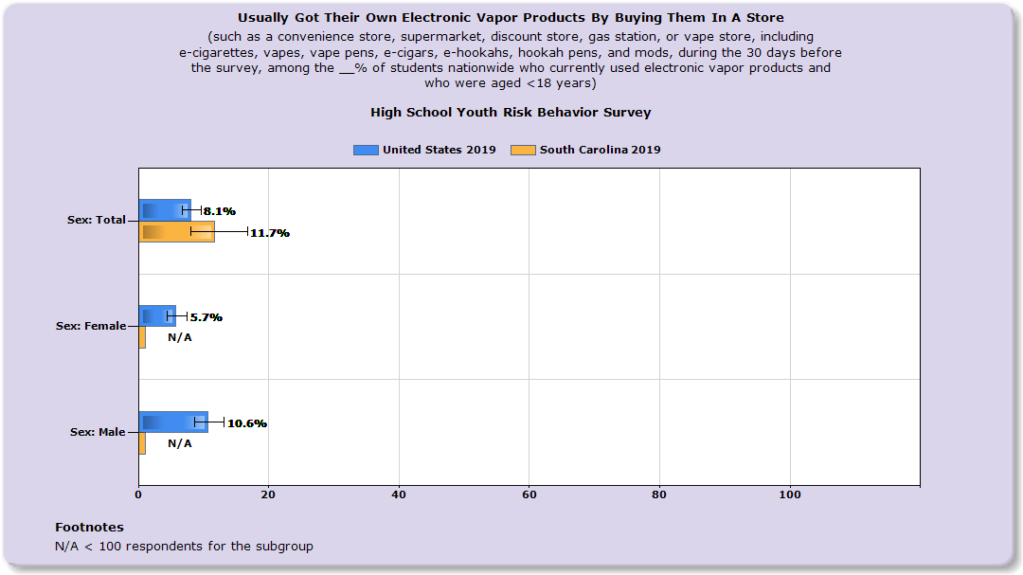
South Carolina Data
Source: https://nccd.cdc.gov/youthonline/App/Results

Slide 46
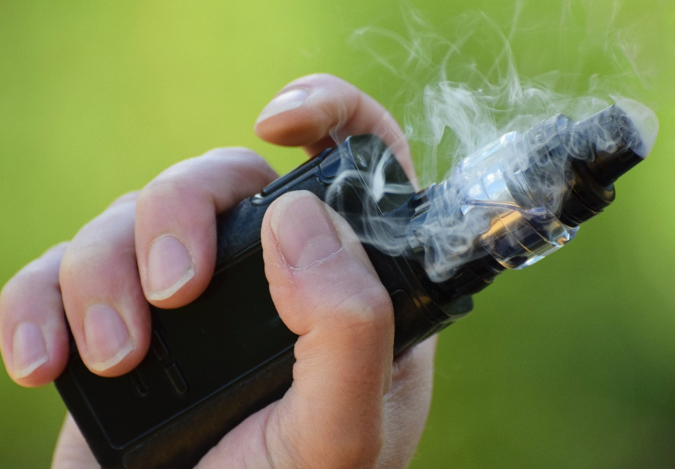
Keep Yourself Vape Educated
Learn and understand popular brands.
Familiarize yourself with how vapes operate.
Pay attention to policy changes with vapes.
Frequently check federal websites such as the FDA and CDC website for updates.

Slide 47
IN CLOSING
Talk to your kids! Have several drug "conversations."
Education and prevention start early.
Drug abuse prevention requires a multifaceted approach.
Seek help from a professional early if needed!

Slide 48
Resources for Parents & Professionals
CDC Quick Vape Facts - https://www.cdc.gov/tobacco/basic_information/e-cigarettes/Quick-Facts-on-the-Risks-of-E-cigarettes-for-Kids-Teens-and-Young-Adults.html
CDC Teen Vape Sheets - https://www.cdc.gov/tobacco/basic_information/e-cigarettes/Quick-Facts-on-the-Risks-of-E-cigarettes-for-Kids-Teens-and-Young-Adults.html
CDC Ecig/Product - Dictionary-images-https://www.cdc.gov/tobacco/basic_information/e-cigarettes/pdfs/ecigarette-or-vaping-products-visual-dictionary-508.pdf
Surgeon General - Vapes-https://e-cigarettes.surgeongeneral.gov/knowtherisks.html
CDC Smoking & Youth - https://www.cdc.gov/tobacco/data_statistics/sgr/50th-anniversary/pdfs/fs_smoking_youth_508.pdf
CDC What Are E Cigs? - https://www.cdc.gov/tobacco/basic_information/e-cigarettes/about-e-cigarettes.html
Vape Facts by Johns Hopkins Medicine - https://www.hopkinsmedicine.org/health/wellness-and-prevention/5-truths-you-need-to-know-about-vaping
TALL COP SAYS STOP Website: www.tallcopsaysstop.com

Slide 49
YOUR CONTACT INFO HERE
Contact Info

